Slide 1
Installation Guide
(Eclipse Plug-in – Spring IDE 2.2
on Eclipse 3.5)
2009. 07. 17
CODELABOR
Shin Sang Jae (codelabor@gmail.com)

Slide 2
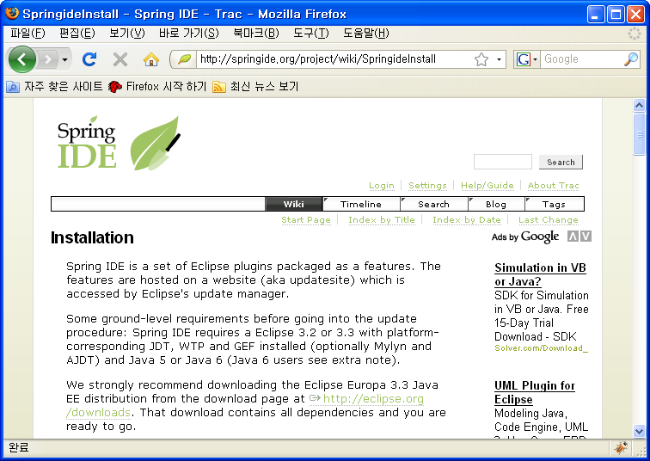
Spring IDE
Site
Officical Site: http://springide.org/blog/

Slide 3
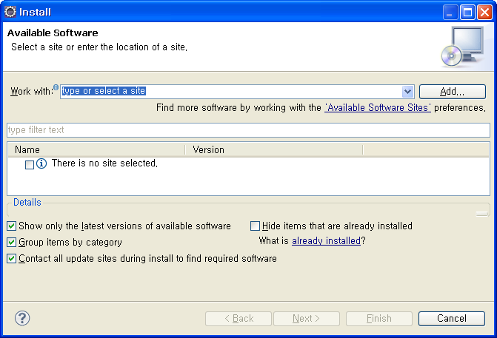
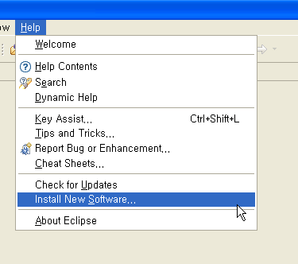
Spring IDE
Install
Menu
  Help > Install New Software...
Install Window
  Work With: > Add

Slide 4
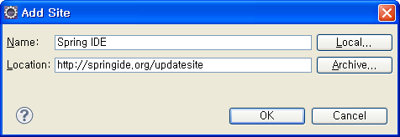
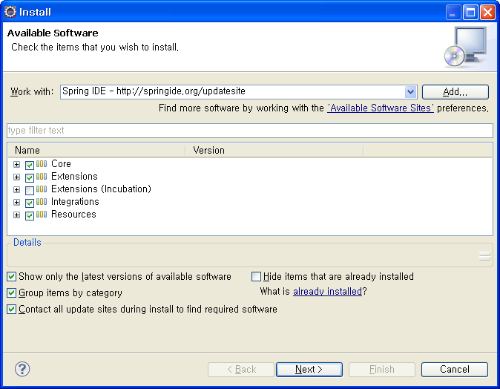
Spring IDE
Add Site
Add Site Windows
  Name: Spring IDE
  Location: http://springide.org/updatesite
  Uncheck Extensions (Incubation)

Slide 5
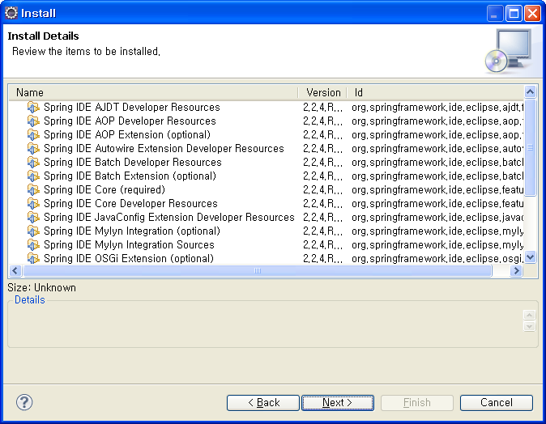
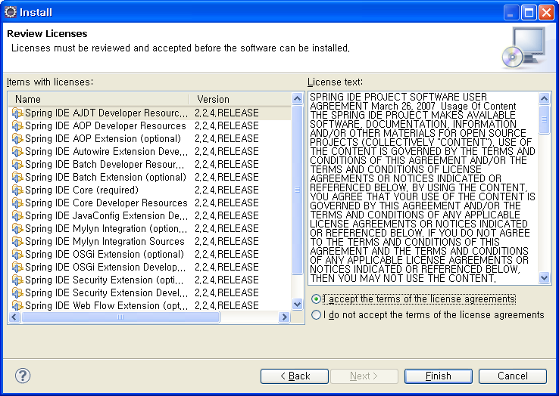
Spring IDE
Install
Install Details Window
Accept the terms of the license agreements

Slide 6
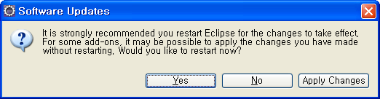
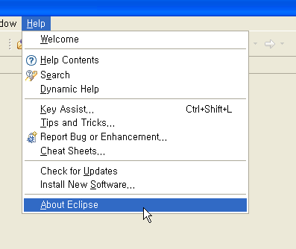
Spring IDE
Software Updates
Software Updates Window
  Restart
Menu
  Help > About Eclipse

Slide 7
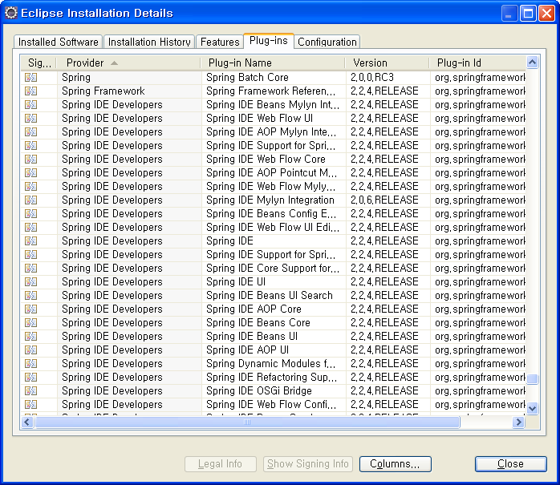
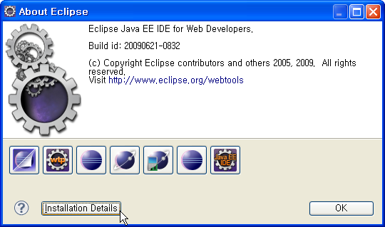
Spring IDE
Software Updates
About Eclipse Window
  Install Details
Eclipse Installation Details Window
  Plug-ins

